Slide 1
BIOMEDICAL NLP · STANCE DETECTION
Cross-Domain and Deep Learning
Approaches for Stance Detection in
Controversial Health Discourses
Classical TF-IDF baselines vs. fine-tuned BERTweet and the limits of cross-topic generalization.
Alex-Matei Ignat
Faculty of Mathematics and Informatics, University of Bucharest
June 24, 2026

Slide 2




MOTIVATION
Why stance detection in health discourse?
Social media has become a primary arena for public debate on health policy, from vaccination mandates to reproductive rights. Automatically detecting whether a post is FAVOR, AGAINST, or NONE toward a target helps track misinformation, gauge policy acceptance, and map societal divides.
A diagnostic task
Stance signals reveal how communities accept or resist public-health guidance in real time.
Two flashpoints
We study COVID-19 vaccination and abortion: highly polarized, high-stakes health debates.
Health microblogs are hard:
Short, unstructured text: heavy on sarcasm and jargon
Stance is often implicit, not stated outright
Models trained on one topic generalize poorly to another
The open challenge
Robust, generalizable stance detection across distinct health domains remains unsolved.
Stance Detection in Controversial Health Discourses
2
Notes:
Set up the problem: social media drives health discourse; stance detection (FAVOR/AGAINST/NONE) is the diagnostic tool. Emphasize the three difficulties — short/sarcastic text, implicit stance, and poor cross-topic generalization — which is the thread of the whole paper.

Slide 3



GOALS
Two research objectives
01
02
Architectural comparison
Cross-domain transferability
Quantify the performance leap from classical statistical baselines, Logistic Regression and SVM over TF-IDF features, to a fine-tuned, transformer-based BERTweet model.
Test zero-shot transfer between two distinct domains: covid-vax-stance and TweetEval abortion, to measure how badly domain shift breaks each model.
Stance Detection in Controversial Health Discourses
3
Notes:
Frame the two questions the paper answers: (1) how much does the architecture matter in-domain, and (2) does that advantage survive a topic change? The second is where the interesting failure lives.

Slide 4



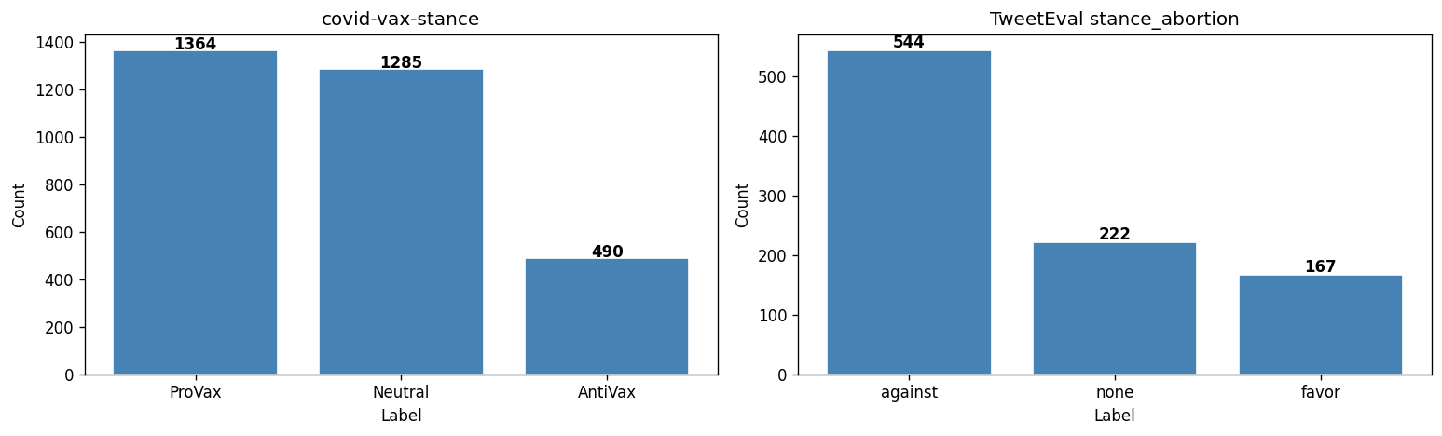
DATASETS
Two contrasting corpora
covid-vax-stance
TweetEval abortion
3,139 tweets
933 tweets
avg. 182.9 chars · ProVax 1364 / Neutral 1285 / AntiVax 490
avg. 105.4 chars · against 544 / none 222 / favor 167
Built for contrast
Vaccine corpus is 3x larger with longer texts; abortion corpus is compact and short.
Class imbalance is inverted: vaccine skews FAVOR/NONE, abortion skews AGAINST.
Labels mapped to a shared taxonomy (FAVOR / AGAINST / NONE) to enable transfer.
Label distribution: inverted imbalance between the two corpora.
Stance Detection in Controversial Health Discourses
4
Notes:
The two datasets were chosen precisely because they differ: size, text length, and direction of class imbalance. Minimal preprocessing (URLs to HTTPURL, mentions to @USER, hashtags de-hashed) and a unified label space make zero-shot transfer testable.

Slide 5



METHODS
Two modeling paradigms
Classical baselines
Deep learning
TF-IDF features
sublinear, unigrams + bigrams, up to 50,000 features
Logistic Regression
fast, interpretable linear classifier
Linear SVM (LinearSVC)
margin-based separation on sparse vectors
BERTweet (vinai/bertweet-base)
RoBERTa pre-trained on 850M English tweets
Fine-tuning recipe
AdamW · 10 epochs · lr 2e-5 · 10% warmup
weight decay 0.01 · batch size 32
Class-weighted loss
inverse-frequency weights counter imbalance (AntiVax 2.13 vs ProVax 0.77)
Stance Detection in Controversial Health Discourses
5
Notes:
Contrast the two families. Classical models are cheap and interpretable but bag-of-words. BERTweet brings contextual embeddings tuned for tweet grammar. The class-weighted cross-entropy is the key trick that lets the deep model not ignore minority classes.

Slide 6

RESULTS
In-domain: BERTweet wins decisively
Macro-F1 leap
0.661 abortion
0.624 vaccine
BERTweet nearly doubles Logistic Regression on abortion (0.66 vs 0.37) and beats every classical baseline on both corpora.
Stance Detection in Controversial Health Discourses
6
Notes:
Headline in-domain result. BERTweet posts the highest Macro-F1 on both datasets, with the largest gap on abortion where LR is nearly half. Contextual embeddings clearly help on short informal health text.

Slide 7

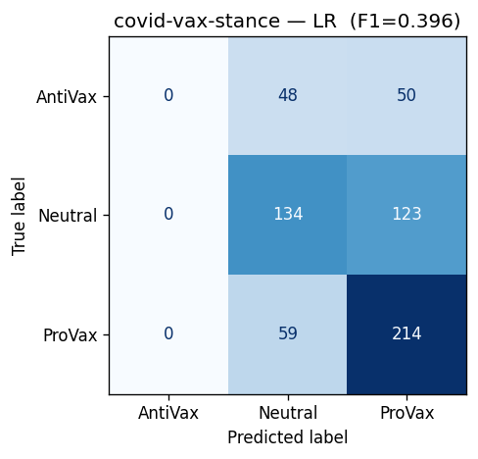
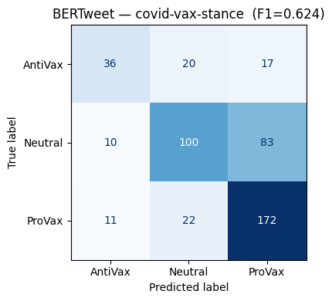
CONFUSION MATRICES · COVID-VAX
Classical models collapse on minorities
The fix
LR defaults entirely to majority classes, having zero correct AntiVax calls.
Class-weighted loss lets BERTweet keep minority recall without ignoring the rare class.
Logistic Regression - 0 true AntiVax predictions
BERTweet - recovers the AntiVax minority
Stance Detection in Controversial Health Discourses
7
Notes:
This is the per-class story. The LR confusion matrix has an empty AntiVax column — it never predicts the minority. BERTweet, with inverse-frequency class weights, actually recovers a chunk of AntiVax. This is why aggregate Macro-F1 differs so much.

Slide 8
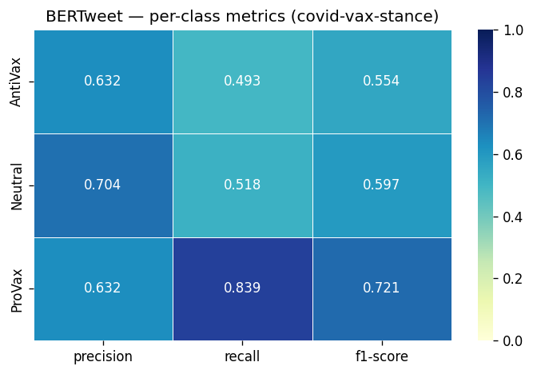

BERTWEET · COVID-VAX
Per-class behaviour, in detail
ProVax: strong recall 0.839
The majority class is captured reliably, with the model rarely missing a pro-vaccine tweet.
AntiVax: precision 0.632, recall 0.493
Class weighting prevents total neglect, but the minority remains the weakest class.
Class overlap still creates ambiguity in boundary cases, weighting mitigates, but does not erase, the imbalance.
Stance Detection in Controversial Health Discourses
8
Notes:
Zoom into precision/recall/F1. ProVax recall is excellent; AntiVax lags on both precision and recall. The takeaway: class weighting helps but does not fully solve minority-class ambiguity at decision boundaries.

Slide 9

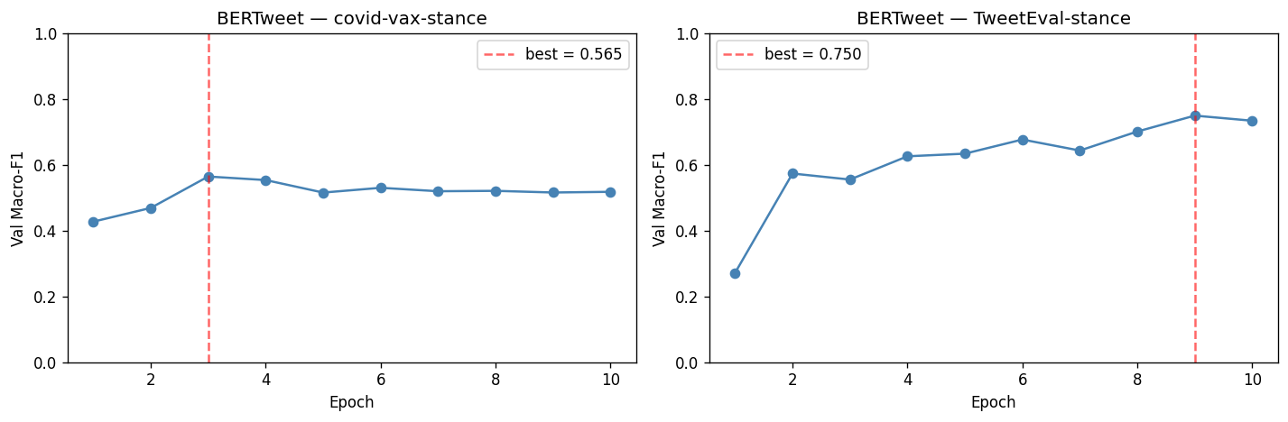
VALIDATION DYNAMICS
Training is stable, not overfit
Converges early
Validation Macro-F1 stabilizes by epochs 3–5 on both corpora.
Best checkpoint kept
Peak-validation weights (0.565 / 0.750) are saved for final inference.
No runaway overfit
Curves plateau rather than diverge, class weights aiding stable convergence.
Stance Detection in Controversial Health Discourses
9
Notes:
Reassure on methodology: with small datasets, overfitting is a worry. The validation curves plateau by epoch 3-5, and we keep the best-validation checkpoint. The 10% warmup and weight decay support stable convergence.

Slide 10
CROSS-DOMAIN
Zero-shot transfer collapses
BERTweet, out of domain
0.27 – 0.30
a ~0.35 Macro-F1 drop from in-domain
Classical models fare even worse
0.119 Logistic Regression, transferred
Catastrophic degradation across every model when the topic changes.
Stance Detection in Controversial Health Discourses
10
Notes:
The central negative finding. Train on one topic, test zero-shot on the other: BERTweet falls from ~0.64 to ~0.28. LR drops to 0.12. Even the strong contextual model does not transfer. This motivates the rest of the discussion.

Slide 11

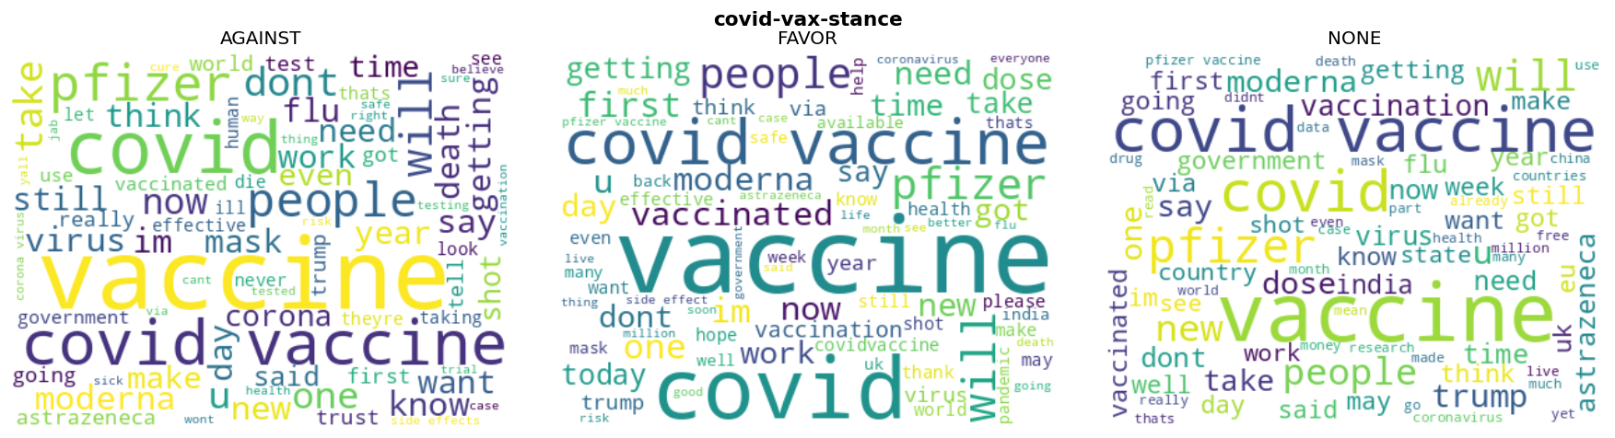
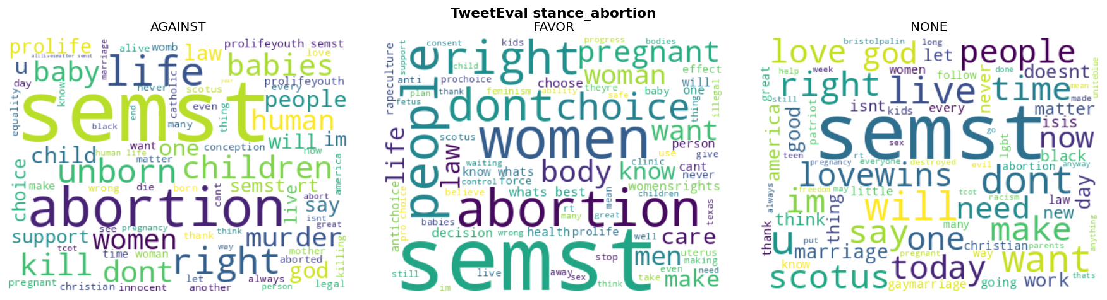
ERROR ANALYSIS
Why? A vocabulary disconnect
Stance anchors don't overlap: “pfizer, dose, mask” vs. “life, women, murder.”
BERTweet overfits its training lexicon: it never learns abstract, domain-invariant markers of opposition or support.
Stance Detection in Controversial Health Discourses
11
Notes:
Explain the mechanism behind the collapse. The word clouds show near-zero lexical overlap between vaccine and abortion discourse. Models latch onto explicit keywords rather than learning what opposition or favor 'looks like' abstractly, so they cannot transfer.

Slide 12

BENCHMARK & QUALITATIVE ANALYSIS
Near-SOTA, with telling errors
Where BERTweet still slips
vs. SemEval-2016 best
0.6615
1
Political grievance ≠ medical opinion
Anti-vaccine sentiment hidden inside political attacks is read as Neutral.
our BERTweet fine-tune (abortion)
2
Formal / academic phrasing
0.6782 first-place submission
Dry, clinical wording gets misread as Neutral, while the model expects emotive language.
Δ 0.0167 from SOTA, with no hand-engineered features.
Political sarcasm
3
Cynical mockery with charged keywords is flagged AntiVax, when in reality it is neutral commentary.
Stance Detection in Controversial Health Discourses
12
Notes:
Two messages. First, a simple fine-tune lands within 0.017 of the original SemEval-2016 winner, without feature engineering — modern transformers are strong out of the box. Second, the residual errors are about intent: political framing, academic tone, and sarcasm all trip up the model.

Slide 13

CONCLUSIONS
Strong in-domain, fragile across domains
Key findings
Future work
BERTweet decisively beats classical baselines in-domain and matches SemEval SOTA without feature engineering.
Zero-shot cross-domain transfer collapses to 0.27–0.30 Macro-F1.
Cause: deep lexical dependency, models lean on keywords, not abstract stance markers.
Adversarial domain adaptation
force the model to learn domain-invariant features.
LLM-based data augmentation
synthesize bridging data that normalizes lexicon across distinct health controversies.
Alex-Matei Ignat · Faculty of Mathematics and Informatics · University of Bucharest
Notes:
Wrap up with the dual message: transformers win in-domain and reach near-SOTA cheaply, but the field has not solved generalization across health topics. Point to adversarial domain adaptation and LLM-based augmentation as the concrete next steps.

